Slide 1
COMS 4111: Introduction to Databases Lecture 20: Some NoSQL Databases
Dr. Donald F. Ferguson
dff9@columbia.edu

Slide 2
a = 3 means
Allocate a slot in memory.
Use “a” to refer the slot.
Put the value x03 in it.
b = a means
Allocate a slot in memory.
Use “b” to refer to it.
Copy the value that is in slot “a” to slot “b”
Well, what does “a + b” means? Depends
If a and b are numbers, the answer is the number 6.
If a and b are strings, the answer is the string “33.”
This is where types come into play. The CPU only understands binary. The higher layer languages maps from the “types” in our mind to the correct bit operations.

Slide 3
Questions? Comments?

Slide 4
NoSQL Databases

Slide 5
Overview (I) (https://en.wikipedia.org/wiki/NoSQL)
A NoSQL (originally referring to "non SQL" or "non relational")^{[1]} database provides a mechanism for storage and retrieval of data that is modeled in means other than the tabular relations used in relational databases. Such databases have existed since the late 1960s, but did not obtain the "NoSQL" moniker until a surge of popularity in the early twenty-first century,^{[2]} triggered by the needs of Web 2.0 companies such as Facebook, Google, and Amazon.com.^{[3][4][5]} NoSQL databases are increasingly used in big data and real-time web applications.^{[6]} NoSQL systems are also sometimes called "Not only SQL" to emphasize that they may support SQL-like query languages.^{[7][8]}
Motivations for this approach include: simplicity of design, simpler "horizontal" scaling to clusters of machines (which is a problem for relational databases),^{[2]} and finer control over availability. The data structures used by NoSQL databases (e.g. key-value, wide column, graph, or document) are different from those used by default in relational databases, making some operations faster in NoSQL. The particular suitability of a given NoSQL database depends on the problem it must solve. Sometimes the data structures used by NoSQL databases are also viewed as "more flexible" than relational database tables.^{[9]}

Slide 6
Overview (I) (https://en.wikipedia.org/wiki/NoSQL)
Many NoSQL stores compromise consistency (in the sense of the CAP theorem) in favor of availability, partition tolerance, and speed. Barriers to the greater adoption of NoSQL stores include the use of low-level query languages (instead of SQL, for instance the lack of ability to perform ad-hoc joins across tables), lack of standardized interfaces, and huge previous investments in existing relational databases.^{[10]} Most NoSQL stores lack true ACID transactions, … …
Instead, most NoSQL databases offer a concept of "eventual consistency" in which database changes are propagated to all nodes "eventually" (typically within milliseconds) so queries for data might not return updated data immediately or might result in reading data that is not accurate, a problem known as stale reads.^{[11]} Additionally, some NoSQL systems may exhibit lost writes and other forms of data loss.^{[12]} Fortunately, some NoSQL systems provide concepts such as write-ahead logging to avoid data loss.^{[13]} For distributed transaction processing across multiple databases, data consistency is an even bigger challenge that is difficult for both NoSQL and relational databases. Even current relational databases "do not allow referential integrity constraints to span databases."^{[14]}

Slide 7
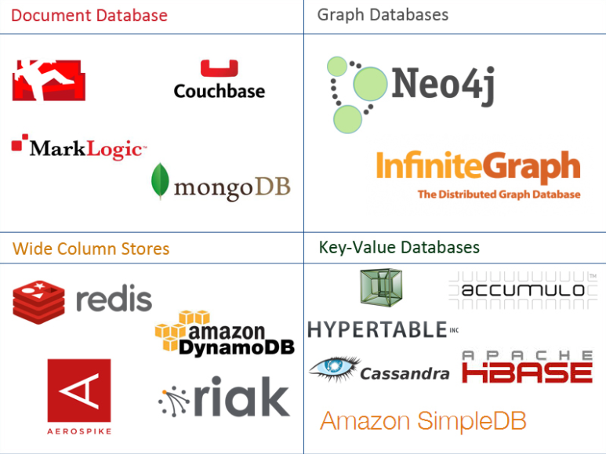
One Taxonomy

Slide 8
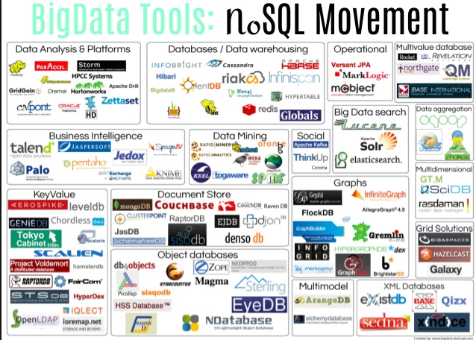
Another Taxonomy

Slide 9
Databases Consistency CAP Theorem Database Models

Slide 10
ACID Databases (https://www.linkedin.com/pulse/what-acid-properties-database-aseem-jain/)

Slide 11
CAP Theorem
Consistency
Every read receives the most recent write or an error.
Availability
Every request receives a (non-error) response – without guarantee that it contains the most recent write.
Partition Tolerance
The system continues to operate despite an arbitrary number of messages being dropped (or delayed) by the network between nodes

Slide 12
Consistency Models
STRONG CONSISTENCY: Strong consistency is a consistency model where all subsequent accesses to a distributed system will always return the updated value after the update.
WEAK CONSISTENCY: It is a consistency model used in distributed computing where subsequent accesses might not always be returning the updated value. There might be inconsistent responses.
EVENTUAL CONSISTENCY: Eventual consistency is a special type of weak consistency method which informally guarantees that, if no new updates are made to a given data item, eventually all accesses to that item will return the last updated value.

Slide 13
Eventual Consistence
Availability and scalability via
Multiple, replicated data stores.
Read goes to “any” replica.
PUT/POST/DELETE
Goes to any replica
Change propagate asynchronously
GET may not see the latest value if the update has not propagated to the replica.
There are several algorithms for conflict resolution
Detect and handle in application.
Clock/change vectors/version numbers
… …
get
put

Slide 14
Core Data Models (http://blog.nahurst.com/visual-guide-to-nosql-systems)
In addition to CAP configurations, another significant way data management systems vary is by the data model they use: relational, key-value, column-oriented, or document-oriented (there are others, but these are the main ones).
Relational systems are the databases we've been using for a while now. RDBMSs and systems that support ACIDity and joins are considered relational.
Key-value systems basically support get, put, and delete operations based on a primary key.
Column-oriented systems still use tables but have no joins (joins must be handled within your application). Obviously, they store data by column as opposed to traditional row-oriented databases. This makes aggregations much easier.
Document-oriented systems store structured "documents" such as JSON or XML but have no joins (joins must be handled within your application). It's very easy to map data from object-oriented software to these systems.

Slide 15
Core Data Models (http://blog.nahurst.com/visual-guide-to-nosql-systems)
In addition to CAP configurations, another significant way data management systems vary is by the data model they use: relational, key-value, column-oriented, or document-oriented (there are others, but these are the main ones).
Relational systems are the databases we've been using for a while now. RDBMSs and systems that support ACIDity and joins are considered relational.
Key-value systems basically support get, put, and delete operations based on a primary key.
Column-oriented systems still use tables but have no joins (joins must be handled within your application). Obviously, they store data by column as opposed to traditional row-oriented databases. This makes aggregations much easier.
Document-oriented systems store structured "documents" such as JSON or XML but have no joins (joins must be handled within your application). It's very easy to map data from object-oriented software to these systems.
There are also graph databases, which we will cover.

Slide 16
Database Models
Consistent, Available (CA) Systems have trouble with partitions and typically deal with it with replication. Examples of CA systems include:
Traditional RDBMSs like Postgres, MySQL, (relational)
Vertica (column-oriented)
Aster Data (relational)
Greenplum (relational)
Consistent, Partition-Tolerant (CP) Systems have trouble with availability while keeping data consistent across partitioned nodes. Examples of CP systems include:
BigTable (column-oriented/tabular)
Hypertable (column-oriented/tabular)
HBase (column-oriented/tabular)
MongoDB (document-oriented)
Terrastore (document-oriented)
Redis (key-value)
Scalaris (key-value)
MemcacheDB (key-value)
Berkeley DB (key-value)
Available, Partition-Tolerant (AP) Systems achieve "eventual consistency" through replication and verification. Examples of AP systems include:
DynamoDB (key-value)
Voldemort (key-value)
Tokyo Cabinet (key-value)
KAI (key-value)
Cassandra (column-oriented/tabular)
CouchDB (document-oriented)
SimpleDB (document-oriented)
Riak (document-oriented)
http://blog.nahurst.com/visual-guide-to-nosql-systems

Slide 17
Database Models
Consistent, Available (CA) Systems have trouble with partitions and typically deal with it with replication. Examples of CA systems include:
Traditional RDBMSs like Postgres, MySQL, (relational)
Vertica (column-oriented)
Aster Data (relational)
Greenplum (relational)
Consistent, Partition-Tolerant (CP) Systems have trouble with availability while keeping data consistent across partitioned nodes. Examples of CP systems include:
BigTable (column-oriented/tabular)
Hypertable (column-oriented/tabular)
HBase (column-oriented/tabular)
MongoDB (document-oriented)
Terrastore (document-oriented)
Redis (key-value)
Scalaris (key-value)
MemcacheDB (key-value)
Berkeley DB (key-value)
Key-Value versus Document can be a little confusing.
Many, if not most, Key-Value stores hold documents.
The difference is
Not in what the data store holds
But how you can query and find it.
Key-Value store finds data by key values explicitly associated with a document.
Document stores allow queries on the fields/values in the document, similar to a relational WHERE on columns.
Available, Partition-Tolerant (AP) Systems achieve "eventual consistency" through replication and verification. Examples of AP systems include:
DynamoDB (key-value)
Voldemort (key-value)
Tokyo Cabinet (key-value)
KAI (key-value)
Cassandra (column-oriented/tabular)
CouchDB (document-oriented)
SimpleDB (document-oriented)
Riak (document-oriented)
http://blog.nahurst.com/visual-guide-to-nosql-systems

Slide 18
Some Queries
MongoDB Query
db.inventory.find( { status: "A", $or: [ { qty: { $lt: 30 } }, { item: /^p/ } ]} )
Finds all documents in the collection wherthe status equals "A" and either qty is less than ($lt) 30 or item starts with the character ”p”
Redis
SADD product:category:1 5 10 // Put product IDs 5 and 10 in category 1.
SMEMBERS product:category:2 // Get the IDs of all products in category 2.
DynamoDB
var params = { TableName : "Movies", KeyConditionExpression: "#yr = :yyyy", ExpressionAttributeNames:{ "#yr": "year" }, ExpressionAttributeValues: { ":yyyy":1985 } };
Dynamo DB
Queries on keys
Scans on values

Slide 19
Columnar (Relational) Database (https://www.dbbest.com/blog/column-oriented-database-technologies/)
Columnar and Row are both
Relational
Support SQL operations
But differ in data storage
Row keeps row data together in blocks.
Columnar keys column data together in blocks.
This determines performance for different types of query, e.g.
Columnar is extremely powerful for BI scenarios
Aggregation ops, e.g. SUM, AVG
PROJECT (do not load all of the row) to get a few columns
Row is powerful for OLTP. Transaction typically create and retrieve
One row at a time
All the columns of a single row.

Slide 20
Graph Database
Exactly what it sounds like
Two core types
Node
Edge (link)
Nodes and Edges have
Label(s) = “Kind”
Properties (free form)
Query is of the form
p1(n)-p2(e)-p3(m)
n, m are nodes; e is an edge
p1, p2, p3 are predicates on labels

Slide 21
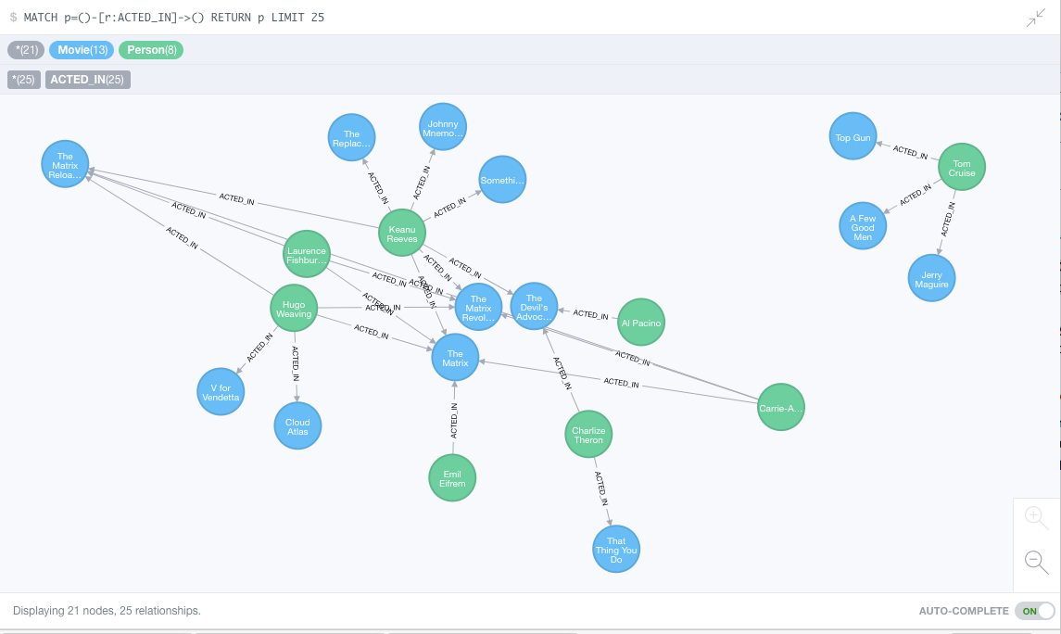
Neo4J Graph Query

Slide 22
Redis

Slide 23
Graph Database

Slide 24
Graph Database
Exactly what it sounds like
Two core types
Node
Edge (link)
Nodes and Edges have
Label(s) = “Kind”
Properties (free form)
Query is of the form
p1(n)-p2(e)-p3(m)
n, m are nodes; e is an edge
p1, p2, p3 are predicates on labels

Slide 25
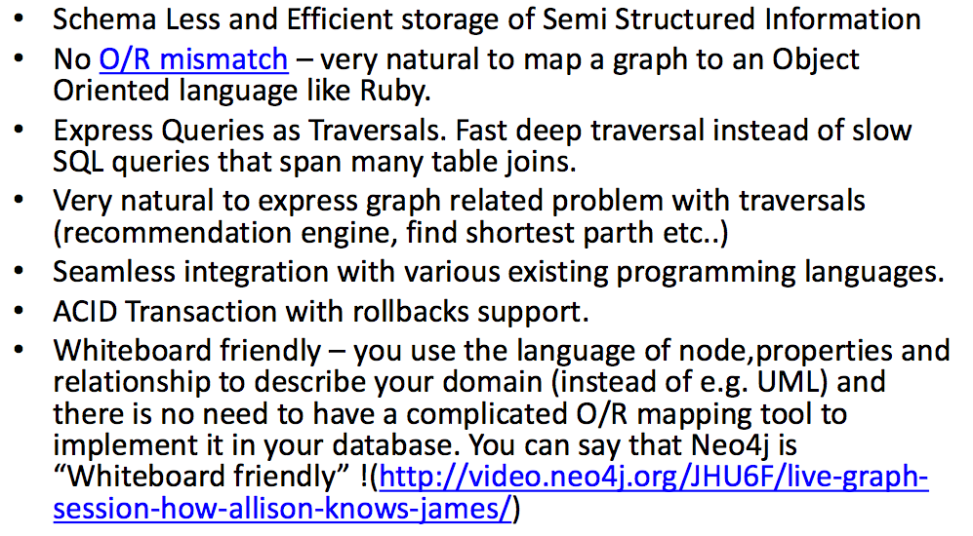
Why Graph Databases? (https://www.slideshare.net/debanjanmahata/an-introduction-to-nosql-graph-databases-and-neo4j)

Slide 26
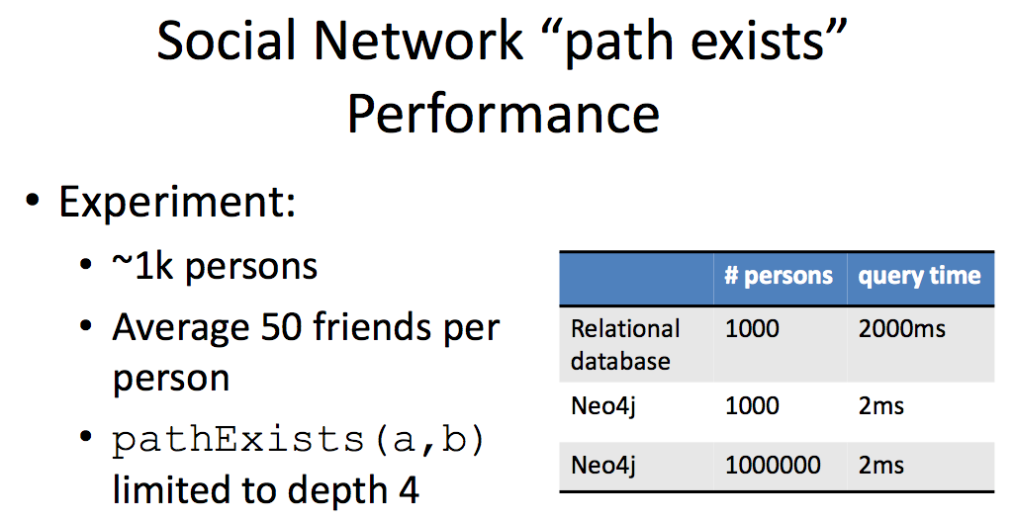
Graph databases are
Extremely fast for some queries and data models.
Implement a language that vastly simplifies writing queries.

Slide 27
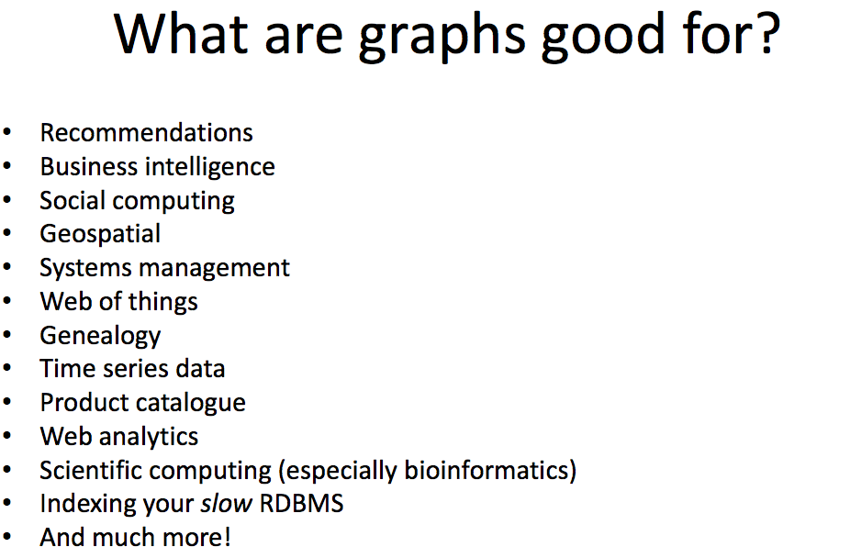

Slide 28
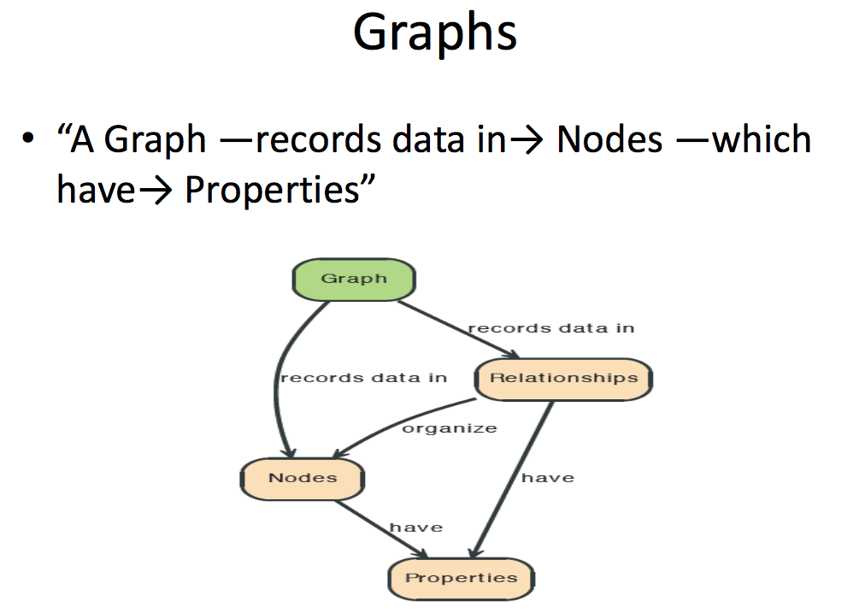

Slide 29
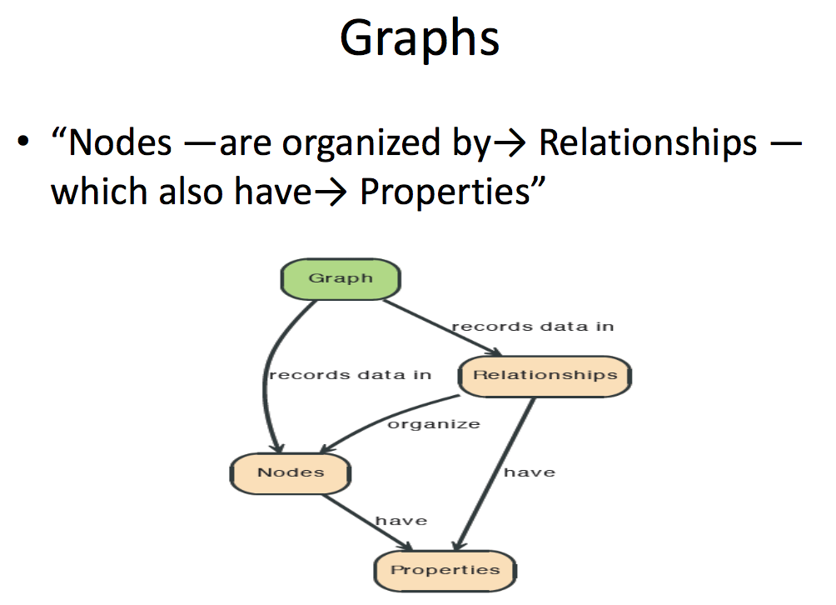

Slide 30
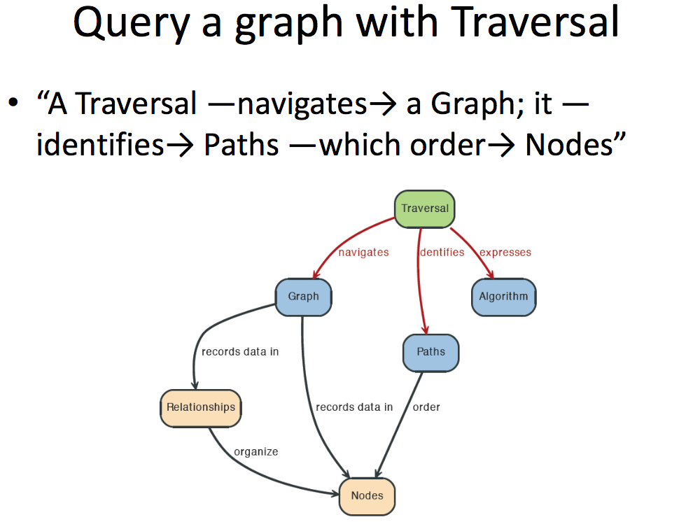

Slide 31
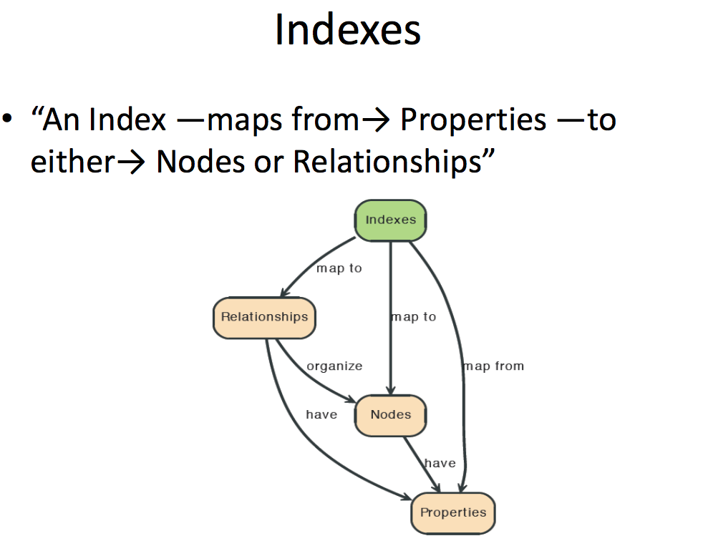

Slide 32
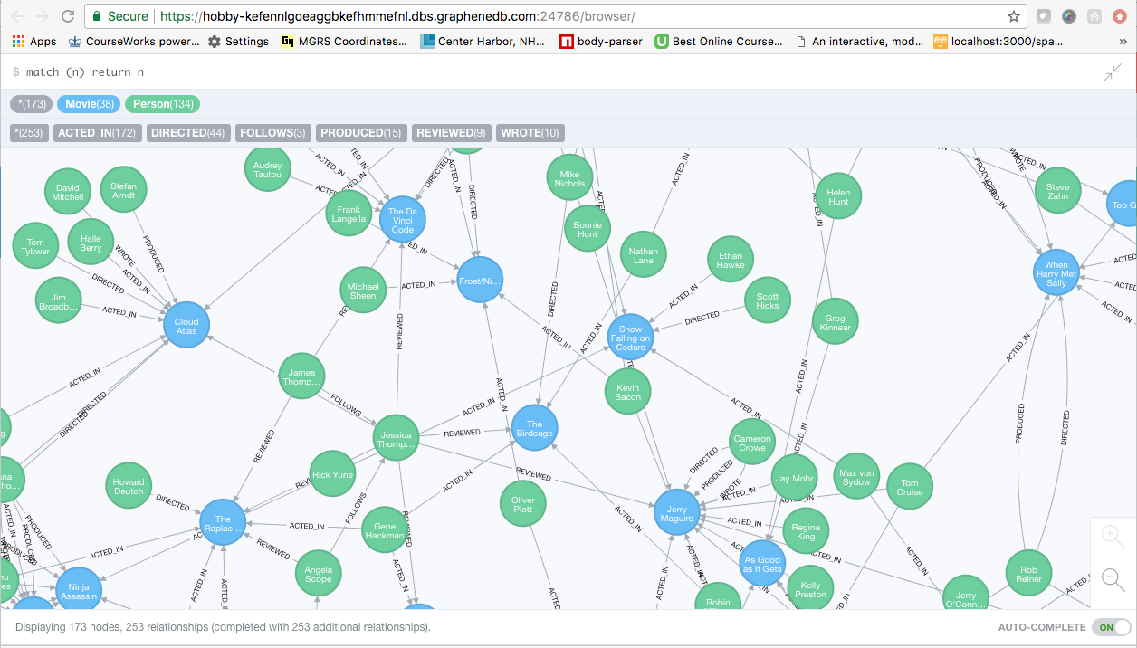
A Graph Database (Sample)

Slide 33
Neo4J Graph Query
Who acted in which movies?

Slide 34
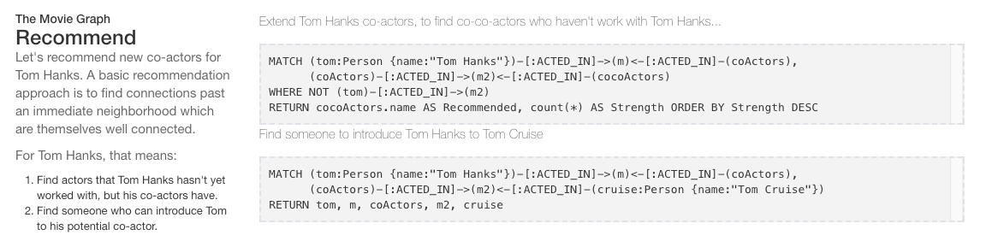
Big Deal. That is just a JOIN.
Yup. But that is simple.
Try writing the queries below in SQL.

Slide 35
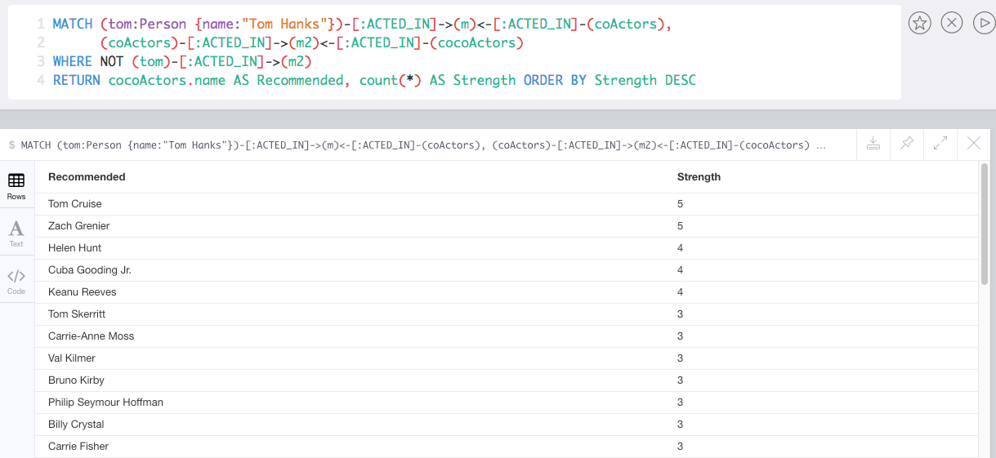

Slide 36
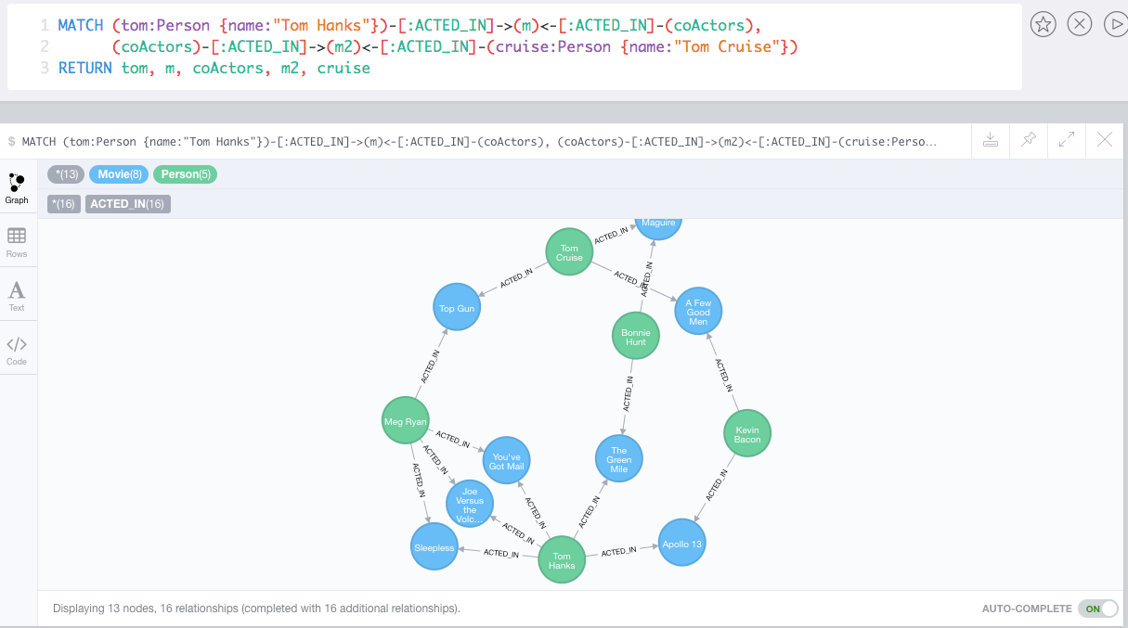
Which actors have worked with both Tom Hanks and
Tom Cruise?

Slide 37
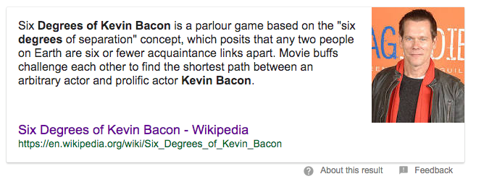
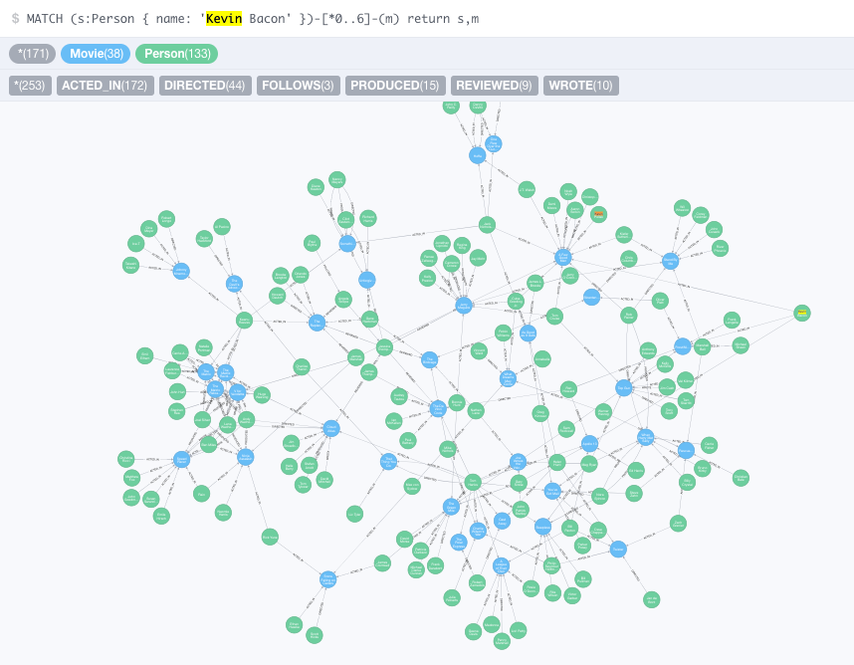
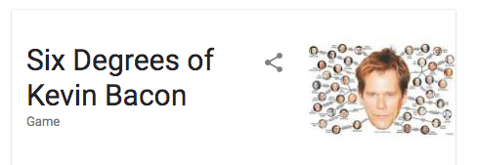

Slide 38
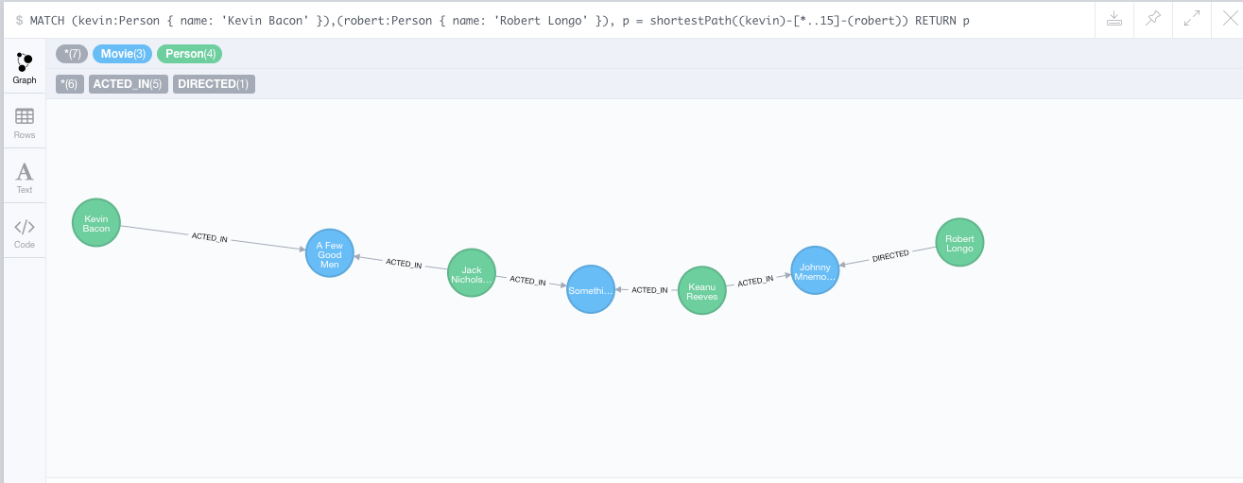
How do you get from Kevin Bacon to
Robert Longo?

Slide 39
Redis

Slide 40



Redis
Redis Key-Value Database:
Practical Introduction
SoftUni Team
Technical Trainers
Software University
http://softuni.bg

Slide 41

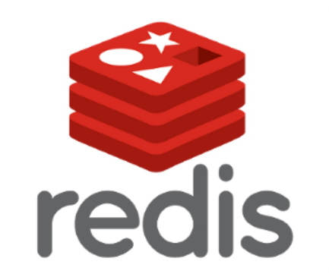
Table of Contents
What is Redis?
Installing and Running Redis
Redis Commands
String Commands
Working with Keys
Working with Hashes
Working with Lists
Working with Sets
Working with Sorted Sets

Slide 42

Redis
Ultra-Fast Data Structure Server

Slide 43
What is Redis?
Redis is:
Ultra-fast in-memory key-value data store
Powerful data structure server
Open-source software: http://redis.io
Redis stores data structures:
Strings, lists, hashes, sets, sorted sets
Publish / subscribe messaging

Slide 44

Redis: Features
Redis is really fast
Non-blocking I/O, single threaded
100,000+ read / writes per second
Redis is not a database
It complements your existing data storage layer
E.g. StackOverflow uses Redis for data caching
For small labs Redis may replace entirely the database
Trade performance for durability → data is persisted immediately

Slide 45
Installing Redis
To install Redis on Linux / Mac OS X:
Download from http://redis.io/download
Install it and run it
To install Redis on Windows:
Download https://github.com/MSOpenTech/redis
Compile the solution in the msvs folder and build it with VS
The easier way: use the Windows package manager Chocolatey
http://chocolatey.org
choco install redis

Slide 46
Running Redis
On Linux / Mac OS X start / stop the Redis service
The default Redis port is 6379 (the service name is redis_6379)
On Windows start / stop the "redis" service
Use the console-based (CLI) client or just connect with Telnet:
sudo service redis_6379 start
sudo service redis_6379 stop
sc start redis
sc stop redis
redis-cli
telnet localhost 6379

Slide 47
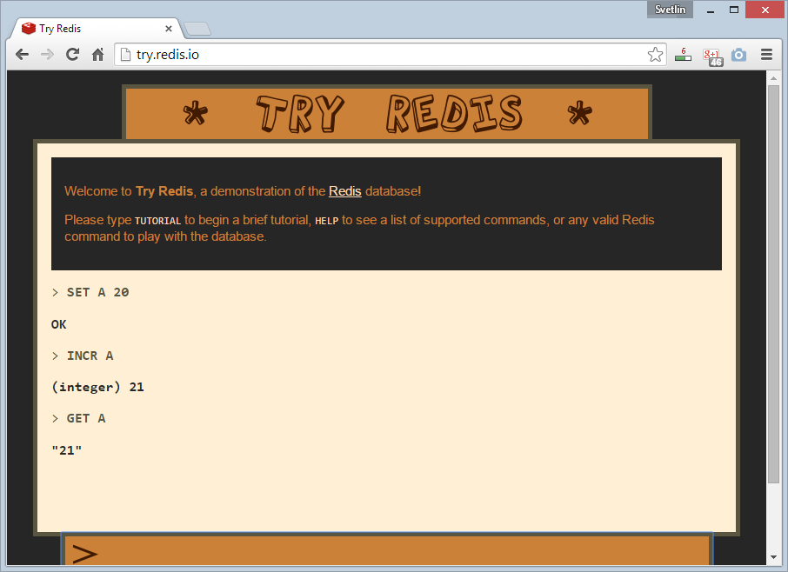
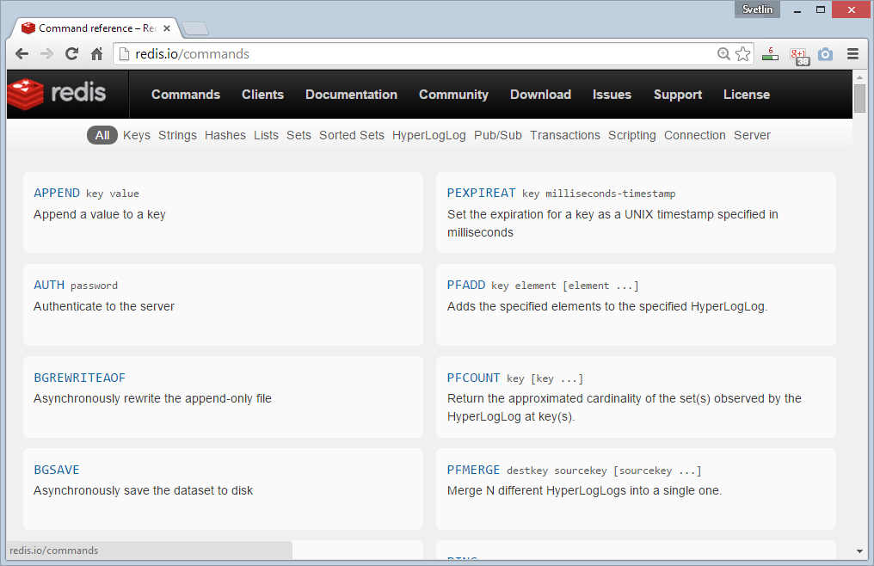
Redis: Basic Commands

Slide 48
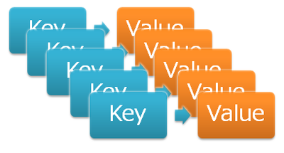
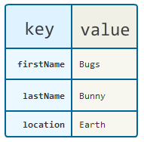
Redis: Data Model
Redis keeps key-value pairs
Every item is stored as key + value
Keys are unique identifiers
Values can be different data structures:
Strings (numbers are stored as strings)
Lists (of strings)
Hash tables: string → string
Sets / sorted sets (of strings)

Slide 49
Redis: Commands
Redis works as interpreter of commands:
SET name "Nakov"
OK
GET name
"Nakov"
DEL name
(integer) 1
GET name
(nil)
Play with the command-line client redis-cli
Or play with Redis online at http://try.redis.io

Slide 50
String Commands
SET [key] [value]
Assigns a string value in a key
GET [key] / MGET [keys]
Returns the value by key / keys
INCR [key] / DECR [key]
Increments / decrements a key
STRLEN [key]
Returns the length of a string
SET name "hi"
OK
GET name
"hi"
SET name abc
OK
GET "name"
"abc"
GET Name
(nil)
SET a 1234
OK
INCR a
(integer) 1235
GET a
"12345"
MGET a name
1) "1235"
2) "asdda"
STRLEN a
(integer) 4

Slide 51
Working with Keys
EXISTS [key]
Checks whether a key exists
TYPE [key]
Returns the type of a key
DEL [key]
Deletes a key
EXPIRE [key] [t]
Deletes a key after t seconds
SET count 5
OK
TYPE count
string
EXISTS count
(integer) 1
DEL count
(integer) 1
EXISTS count
(integer) 0
SET a 1234
OK
GET a
"1234"
EXPIRE a 5
(integer) 1
EXISTS a
(integer) 1
EXISTS a
(integer) 0

Slide 52
Working with Hashes (Hash Tables)
HSET [key] [field] [value]
Assigns a value for given field
HKEYS [key]
Returns the fields (keys) is in a hash
HGET [key] [field]
Returns a value by fields from a hash
HDEL [key] [field]
Deletes a fields from a hash
HSET user name "peter"
(integer) 1
HSET user age 23
(integer) 1
HKEYS user
1) "name"
2) "age"
HGET user age
"23"
HDEL user age
(integer) 1

Slide 53
Working with Lists
RPUSH / LPUSH [list] [value]
Appends / prepend an value to a list
LINDEX [list] [index]
Returns a value given index in a list
LLEN [list]
Returns the length of a list
LRANGE [list] [start] [count]
Returns a sub-list (range of values)
RPUSH names "peter"
(integer) 1
LPUSH names Nakov
(integer) 1
LINDEX names 0
"Nakov"
LLEN names
(integer) 2
LRANGE names 0 100
1) "Nakov"
2) "peter"

Slide 54
Working with Sets
SADD [set] [value]
Appends a value to a set
SMEMBERS [set]
Returns the values from a set
SREM [set] [value]
Deletes a value form a set
SCARD [set]
Returns the stack size (items count)
SADD users "peter"
(integer) 1
SADD users "peter"
(integer) 0
SADD users maria
(integer) 1
SMEMBERS users
1) "peter"
2) "maria"
SREM users maria
(integer) 1

Slide 55
Working with Sorted Sets
ZADD myzset 1 "one"
(integer) 1
ZADD myzset 1 "uno"
(integer) 1
ZADD myzset 2 "two" 3 "three"
(integer) 2
ZRANGE myzset 0 -1 WITHSCORES
1) "one"
2) "1"
…
Learn more at http://redis.io/commands#sorted_set

Slide 56
Publish / Subscribe Commands
First user subscribes to certain channel "news"
Another user sends messages to the same channel "news"
Learn more at http://redis.io/commands#pubsub
SUBSCRIBE news
1) "subscribe"
2) "news"
3) (integer) 1
PUBLISH news "hello"
(integer) 1

Slide 57
Using Redis as a Database
Special naming can help using Redis as database
Add a user "peter".
SADD users:names peter
HSET users:peter name "Peter Petrov"
HSET users:peter email "pp@gmail.com"
SADD users:names maria
HSET users:maria name "Maria Ivanova"
HSET users:maria email "maria@yahoo.com"
SMEMBERS users:names
HGETALL users:peter
Use "users:peter" as key to hold user data
Add a user "maria".
List all users
List all properties for user "peter"

Slide 58


Summary
Redis is ultra-fast in-memory data store
Not a database, used along with databases
Supports strings, numbers, lists, hashes, sets, sorted sets, publish / subscribe messaging
Used for caching / simple apps
Databases

Slide 59







Redis
https://softuni.bg/courses/databases

Slide 60
License
This course (slides, examples, demos, videos, homework, etc.) is licensed under the "Creative Commons Attribution-NonCommercial-ShareAlike 4.0 International" license
Attribution: this work may contain portions from
"Databases" course by Telerik Academy under CC-BY-NC-SA license

Slide 61





Free Trainings @ Software University
Software University Foundation – softuni.org
Software University – High-Quality Education, Profession and Job for Software Developers
softuni.bg
Software University @ Facebook
facebook.com/SoftwareUniversity
Software University @ YouTube
youtube.com/SoftwareUniversity
Software University Forums – forum.softuni.bg

